Slide 2
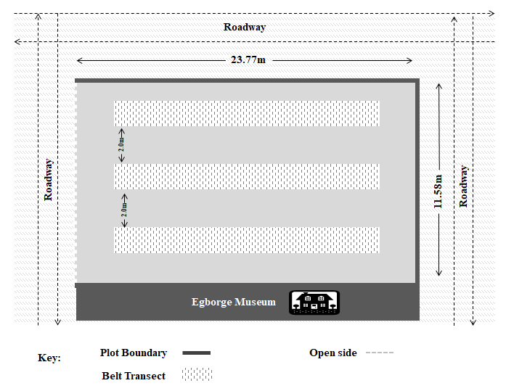
1 2
3 4
5 6
1 2
3 4
5 6
1 2
3 4
5 6
1 2
3 4
5 6
1 2
3 4
5 6
1 2
3 4
5 6
A B C D E F
Numbers (1-6) are 1m by 1m quadrants
Plots

Slide 3
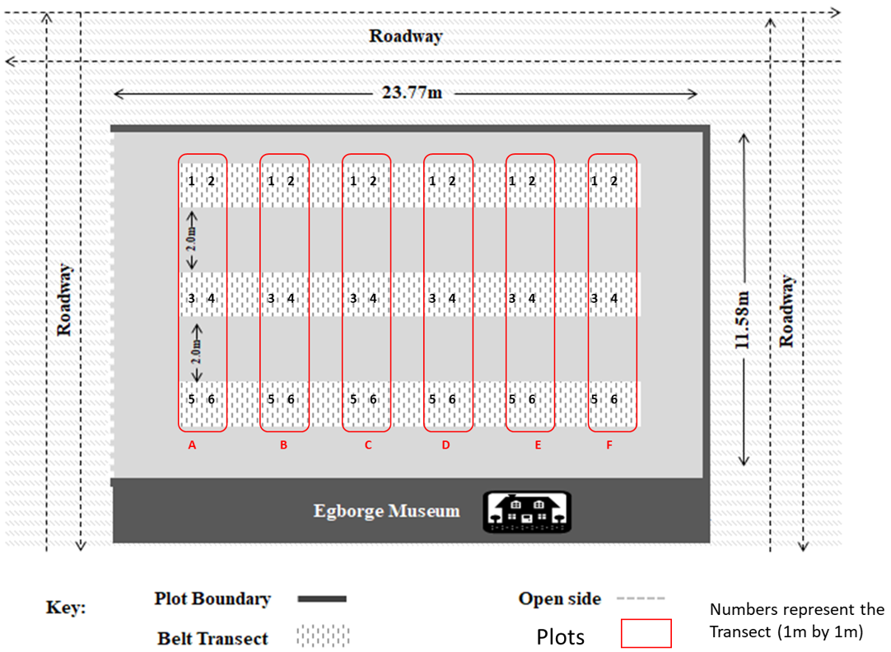
1 2
3 4
5 6
1 2
3 4
5 6
1 2
3 4
5 6
1 2
3 4
5 6
1 2
3 4
5 6
1 2
3 4
5 6
R1 R2 R3 R4 R5 R6
Numbers (1-6) are the 1 × 1 m quadrats

